Slide 1
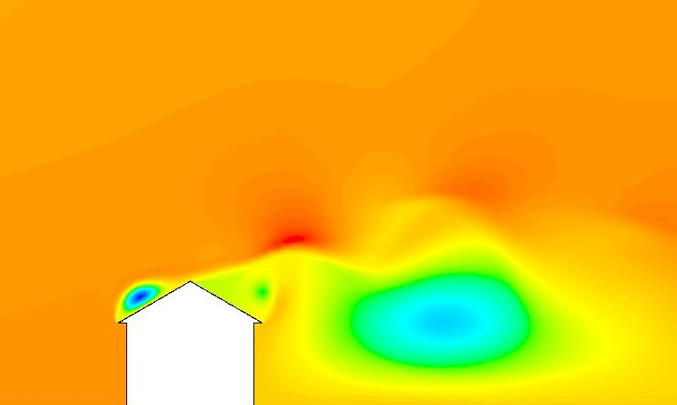
Obtekanie a odpor telies
prof. Ing. Dušan Kudelas, PhD

Slide 2
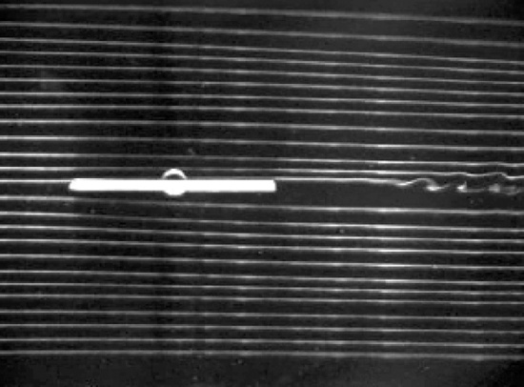
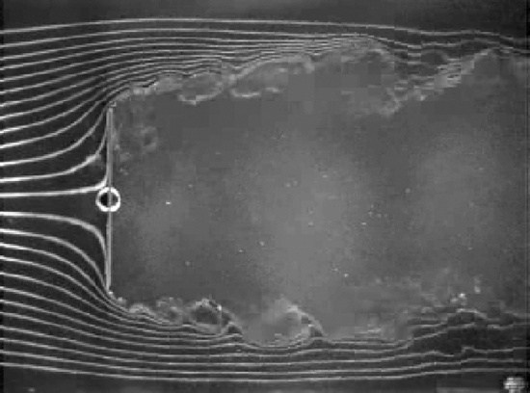
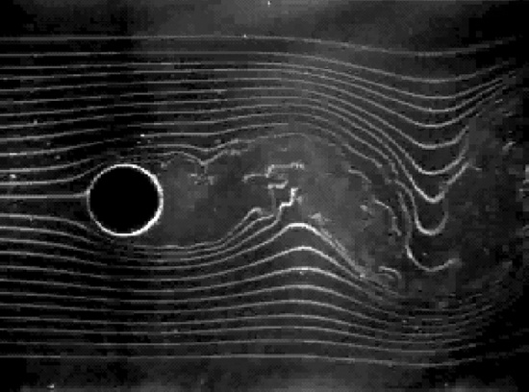
Telesá a sily
Drag = pressure + friction
Odpor = tlakový + trecí
Fluid dynamic forces are comprised of pressure and friction effects.
Often useful to decompose,
  F_{D} = F_{D,friction} + F_{D,pressure}
  C_{D} = C_{D,friction} + C_{D,pressure}
This forms the basis of ship model testing where it is assumed that
  C_{D,pressure} = f(Fr)
  C_{D,friction} = f(Re)

Slide 3
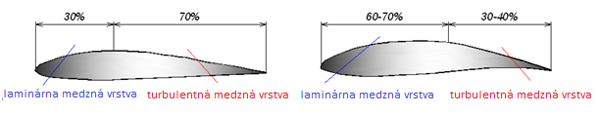
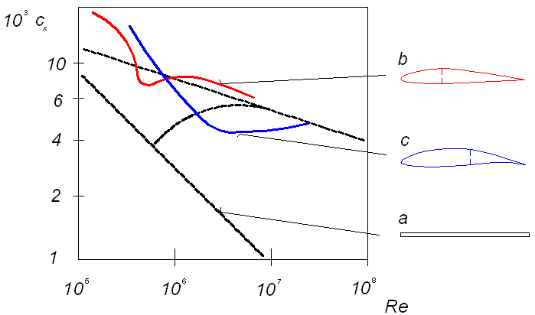
Telesá s dominantným trecím odporom

Slide 4
DRAG COEFFICIENT - C_{D}
C_{D} = F_{D} / (¹/₂ ρU²A)
Flow over a flat plate: F_{D} = ∫_{plate surface} τ_{w}dA
C_{D} = ∫_{PS}τ_{w}dA / (¹/₂ ρU²A)
C_{f} = τ_{w}/(¹/₂ ρU²)
{C_{f} = shear stress or skin friction coef.}
C_{D} = (1/A)∫_{PS}C_{f} dA
(good for laminar and turbulent flow)

Slide 5
Flow over a flat plate with zero pressure gradient:
C_{D} = (1/A) ∫_{PS} C_{f}dA
C_{f} = 0.664/Re^{1/2} for laminar flow
(Blasius solution – flat plate laminar flow
& no pressure gradient)
C_{D} = (1/A)∫_{A} (0.664/Re^{1/2}) dA
= (bL)⁻¹ ∫₀^{L} (0.664 U^{-1/2}x^{-1/2}ν^{1/2}) bdx
= (0.664/L) (ν/U)^{1/2} (2)x^{1/2}⎮_{o}^{L} = 1.33 (ν / LU)^{1/2}
C_{D} = 1.33 (Re_{L}) ^{-1/2} for laminar flow over a flat plate,
with no pressure gradient

Slide 6
Flow over a flat plate with zero pressure gradient:
C_{D} = (1/A) ∫_{PS} C_{f}dA
C_{f} = 0.0594/Re^{1/5} for turbulent flow
(u/U = [y/δ]^{1/7})
(Blasius correlation: f = 0.316/Re^{1/4}; Re ≤ 10⁵)
C_{D} = (1/A)∫_{A} (0.0594/Re^{0.2}) dA
= (bL)⁻¹ ∫₀^{L} (0.0594 (U/ν)^{-0.2}x^{-0.2} bdx
= (0.0594/L) (ν/U)^{0.2} [x^{0.8}/0.8]⎮_{o}^{L}
= 0.0742(ν/UL)^{0.2}
C_{D} = 0.0742 (Re_{L}) ^{–0.2} for turbulent flow over a flat
plate, with no pressure gradient - 5x10⁵ <Re_{L}<10⁷

Slide 7
C_{D} = 1.33 (Re_{L}) ^{-1/2} for laminar flow over a flat plate, with no pressure gradient ~ Re < 5x10⁵
C_{D} = 0.0742 (Re_{L}) ^{–0.2*} for turbulent flow over flat
plate, with no pressure gradient ~ 5x10⁵ <Re_{L}<10⁷
C_{D} = 0.455/ log (Re_{L})^{2.58*} for turbulent flow over flat
plate, with no pressure gradient ~ Re_{L}<10⁹
* Assumes turbulent boundary layer begins at x=o

Slide 8

C_{D} correction term for
partly laminar / partly turbulent

Slide 9
C_{D} correction term for
partly laminar / partly turbulent
ADD
OR
SUBTRACT
CORRECTION
TERM ???
?

Slide 10
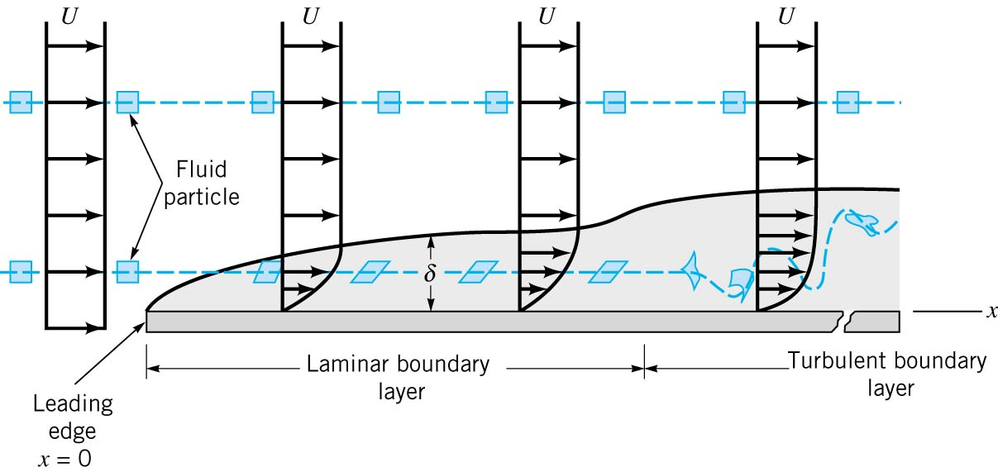
Must account for fact that turbulence
does not start at x = 0
-must subtract B/Re_{L}
C_{D} correction term = B/Re_{L} = Re_{tr}(C_{Dturb} – C_{dlam})/Re_{L}
Re_{tr}

Slide 11
5 x 10⁵ < Re_{L} < 10⁷
Re_{tr}
C_{D} correction term = B/Re_{L} = Re_{tr}(C_{Dturb} – C_{Dlam})/Re_{L}
For Re_{tr} = 5 x 10⁵
C_{D} = 0.0742/Re_{L}^{1/5} – Re_{tr}(C_{Dturb} – C_{Dlam})/Re_{L}
C_{D} = 0.0742/Re_{L}^{1/5}
– 5x10⁵[0.0742/ (5x10⁵)^{1/5}–1.33/(5x10⁵)^{1/2}]/Re_{L}
C_{D} = 0.0742/Re_{L}^{1/5} – 1748/Re_{L}
Notes:
Because C_{d}turb which is in B depends on Re range.

Slide 12
5 x 10⁵ < Re_{L} < 10⁹
Re_{tr}
C_{D} correction term = B/Re_{L} = Re_{tr}(C_{Dturb} – C_{Dlam})/Re_{L}
For Re_{tr} = 5 x 10⁵
C_{D} = 0.0742/Re_{L}^{1/5} – Re_{tr}(C_{Dturb} – C_{Dlam})
C_{D}=0.0742/Re_{L}^{1/5}–5x10⁵[0.455/ (log[5x10⁵])^{1/5}–1.33/(5x10⁵)^{1/2}]
C_{D} = 0.455/(logRe_{L})^{2.58} – 1600/Re_{L}
Notes:
Because C_{d}turb which is in B depends on Re range.

Slide 13
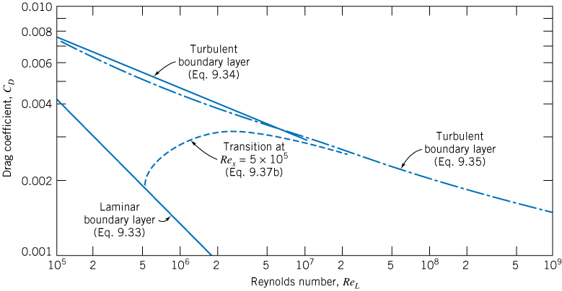
SMOOTH FLAT PLATE
NO PRESSURE GRADIENT
C_{D} = 0.0742 (Re_{L}) ^{–0.2}
C_{D} = 0.455/ log (Re_{L})^{2.58}
C_{D} = 1.33 (Re_{L}) ^{-1/2}

Slide 14

Rough Flat Plate

Slide 15
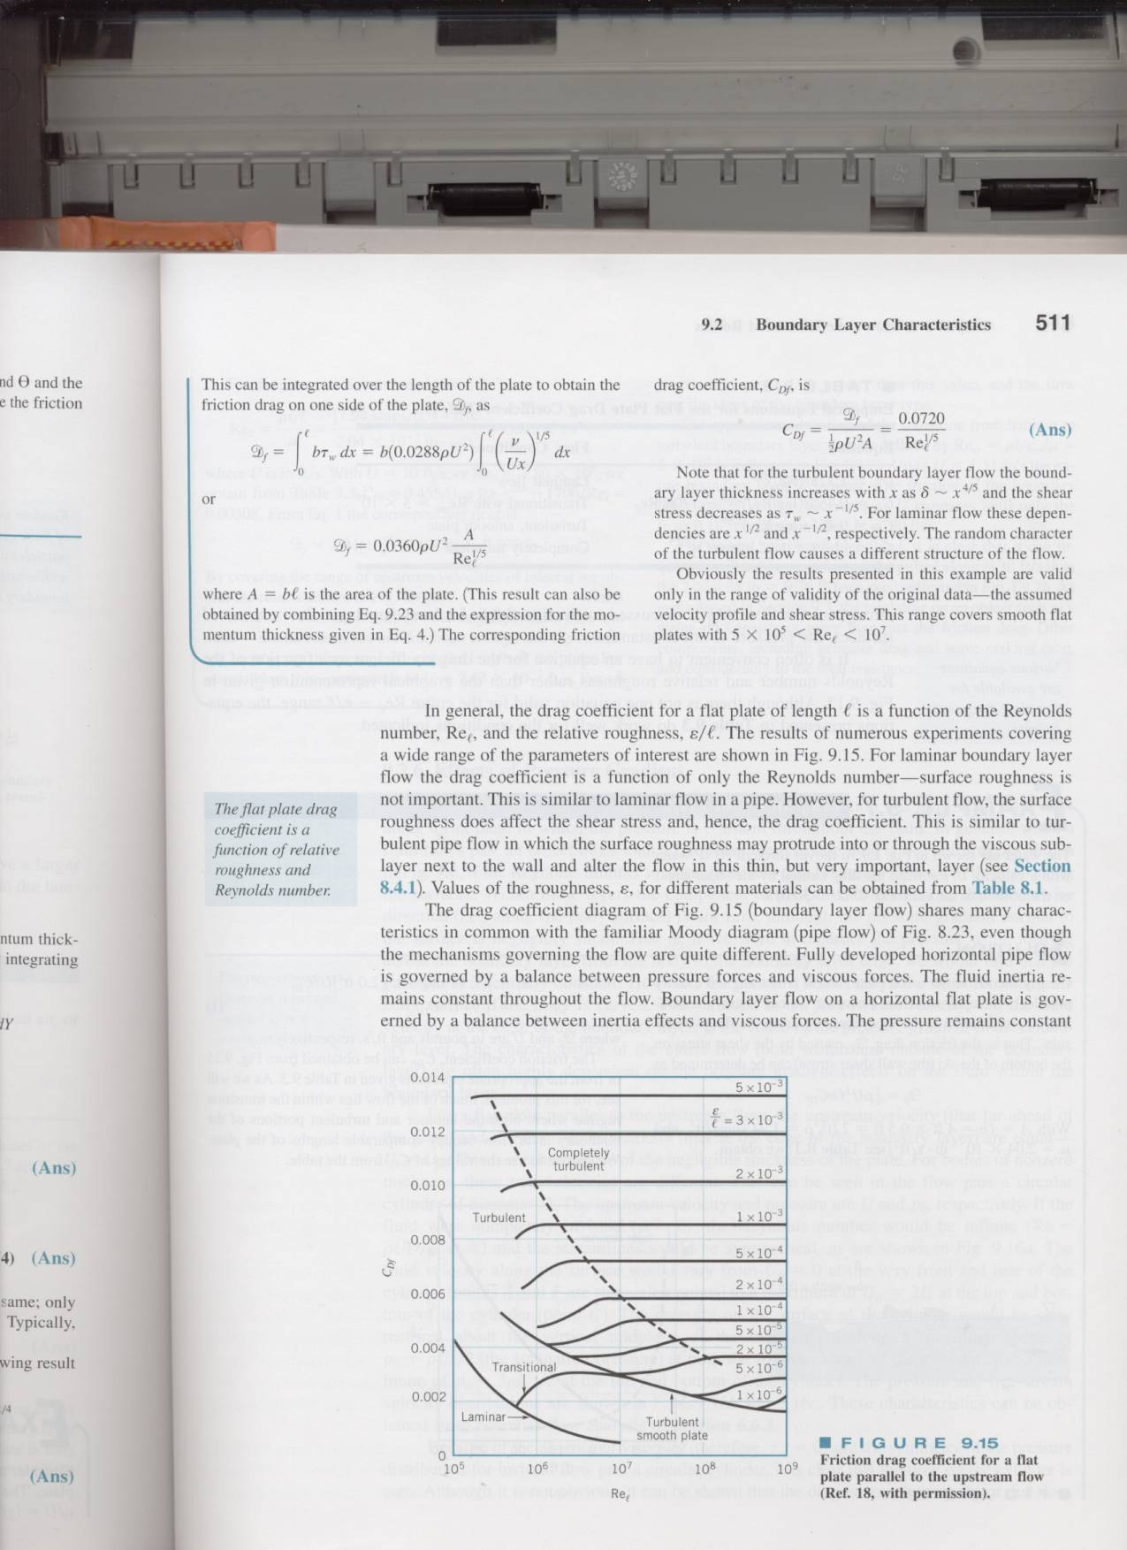
FLAT PLATE
C_{D} =
D/( ½ ρU²A)
Re_{L}
Notes:
Both flat plate and pipe do not have wakes.
Both have similar laminar and turbulent trends and function of roughness

Slide 16
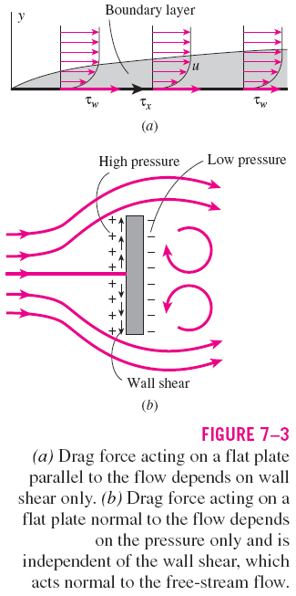
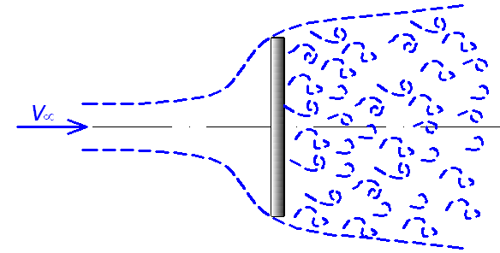
Telesá s dominantným tlakovým odporom

Slide 17
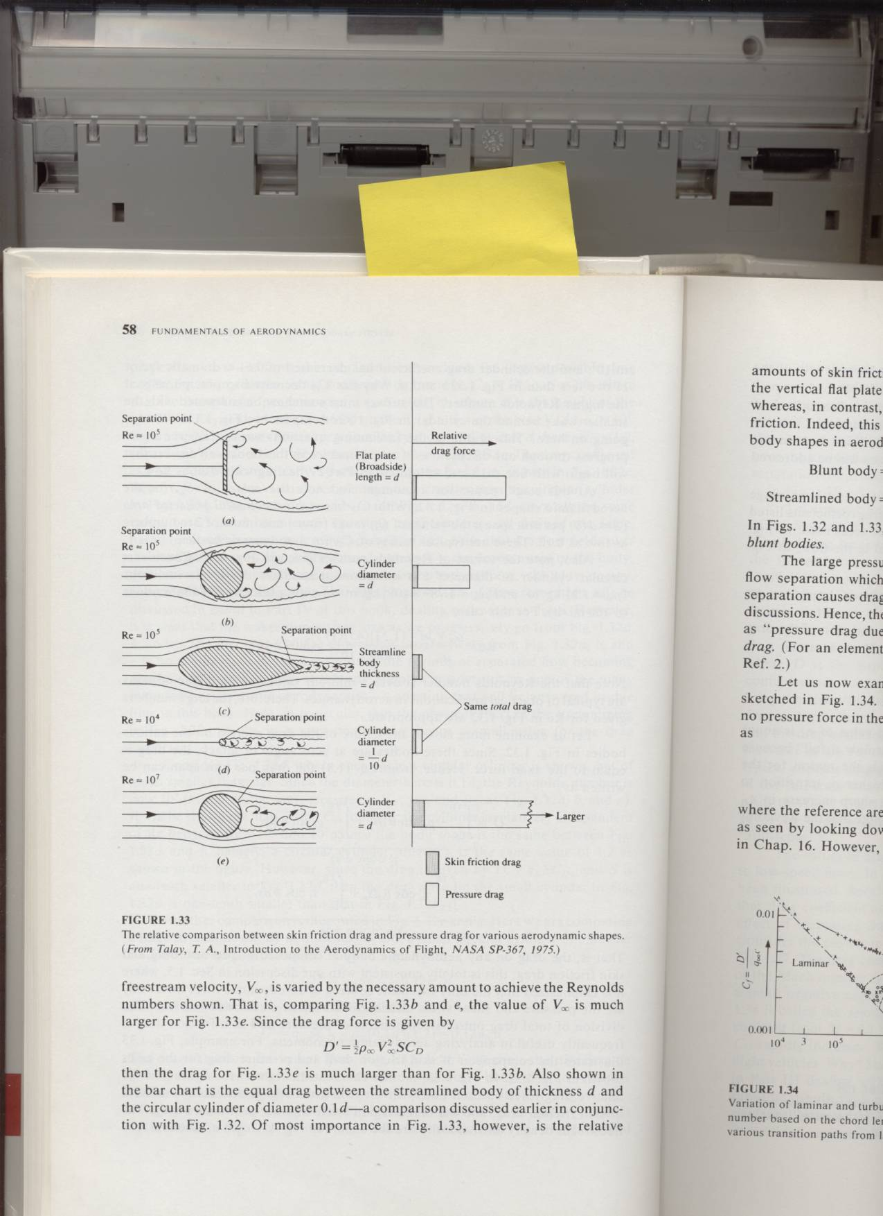
(fixed)
Drag Force = Δp/Δt = Δ(mv)/Δt
m ~ ρUA_{f} = mass per second passing through area
Δv ~ U-0 = U
C_{D} = D/(¹/₂ ρU²A_{f}) ~ ρUA_{f}U/(¹/₂ρU²A_{f})
C_{D} ~ 2 Newton
Value is right order of magnitude,
& Re insensitivity predicted correctly.

Slide 18
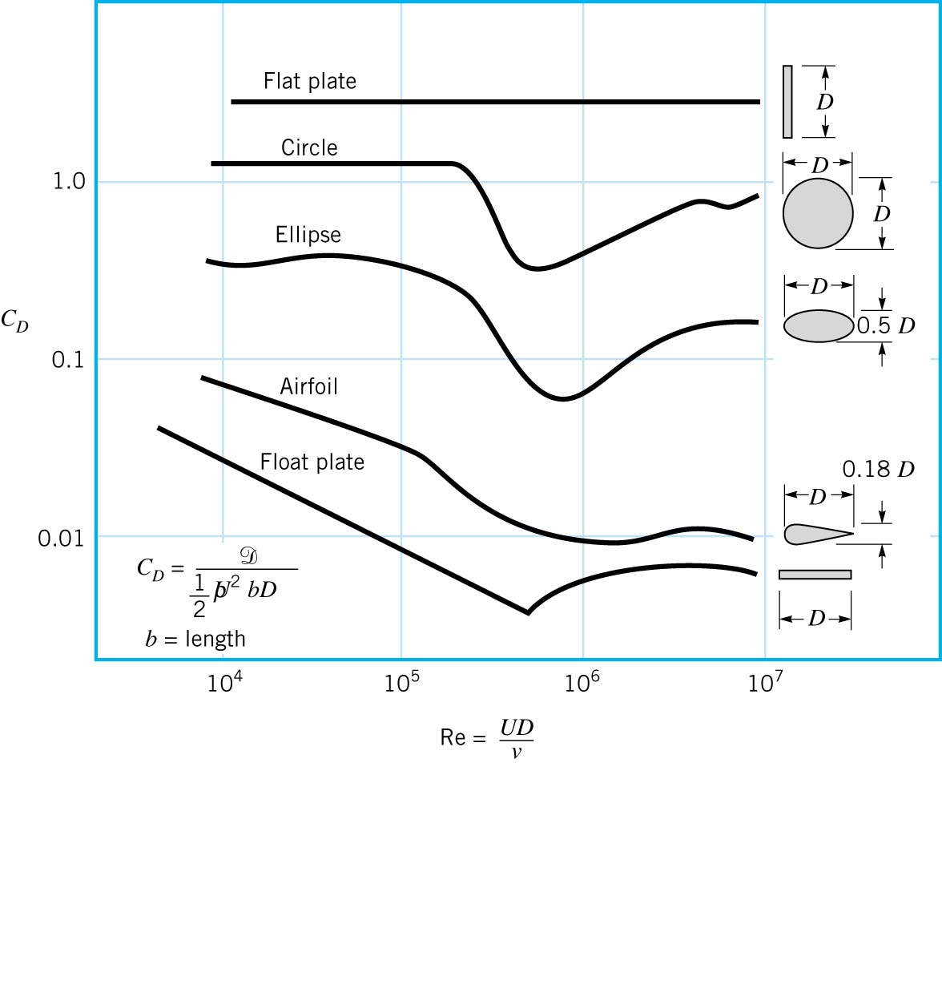
Character of C_{D} vs Re curves for different shapes
Mostly pressure drag, separation point fixed
press
& fric
Friction
drag

Slide 19
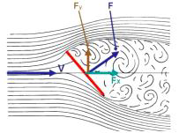
Obtekanie šikmej dosky

Slide 20
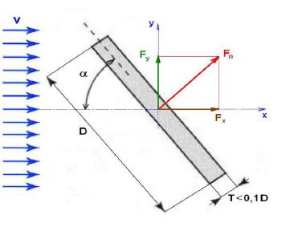

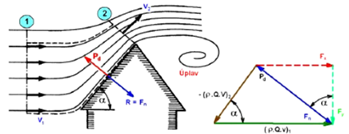
Analytické riešenie
do 8°
od 8°

Slide 21
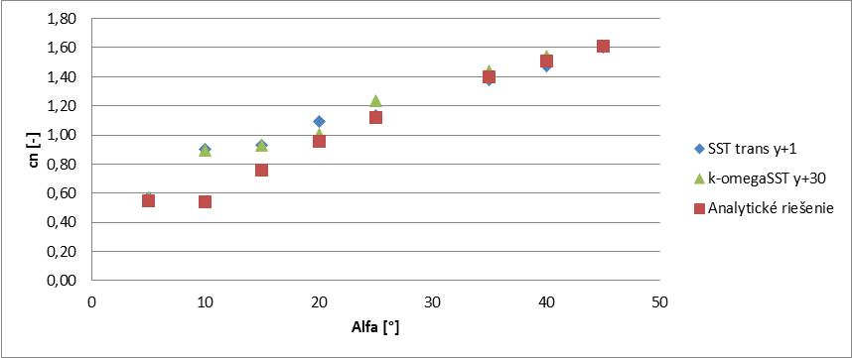
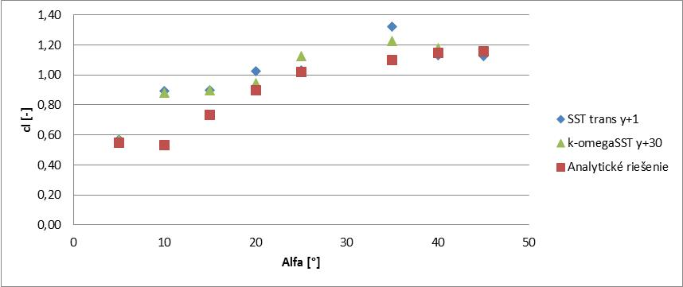
Numerické riešenie sa realizovalo pre rýchlosti prúdenia 6 m/s a 20 m/s resp. (Re= 330 000, a 1120 000), modelmi turbulencie k-omega SST a SST transition.

Slide 22
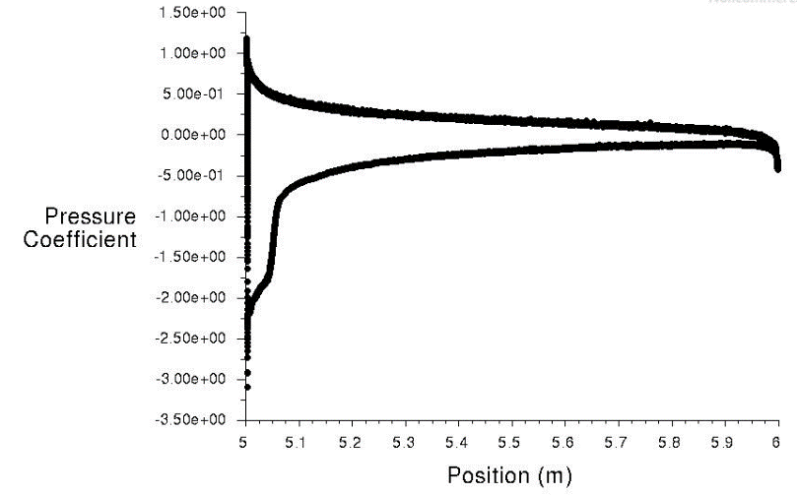
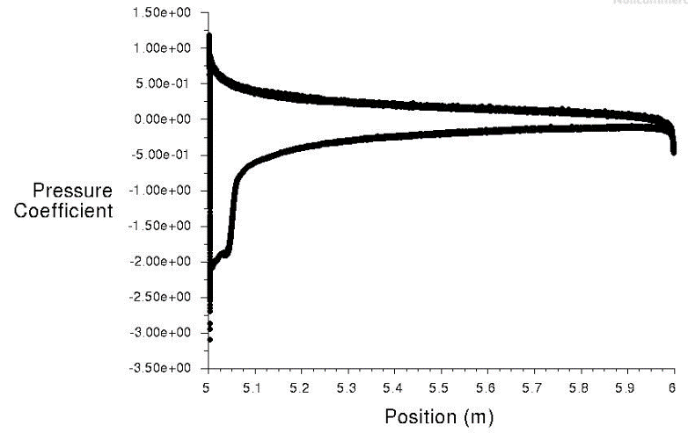
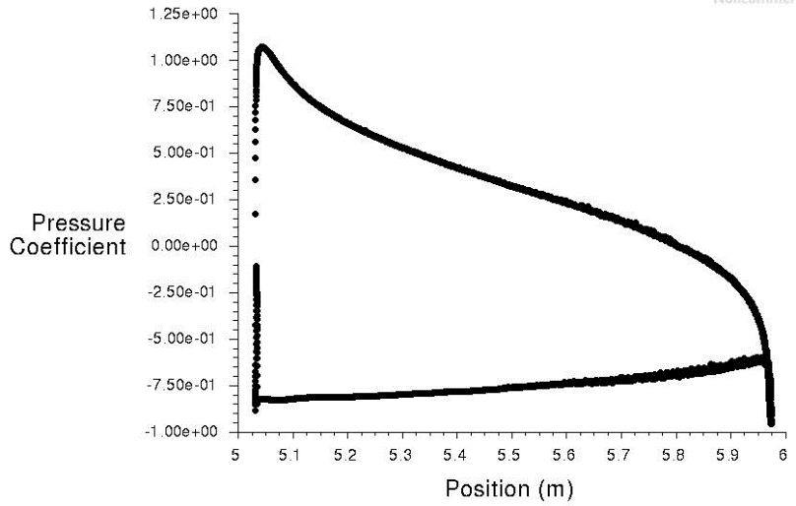
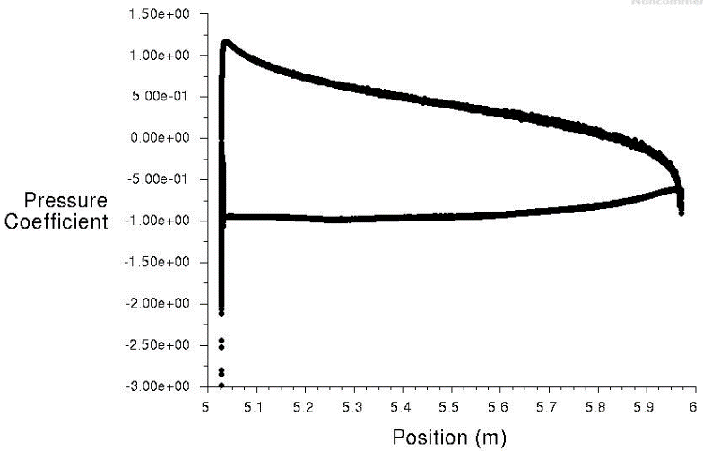
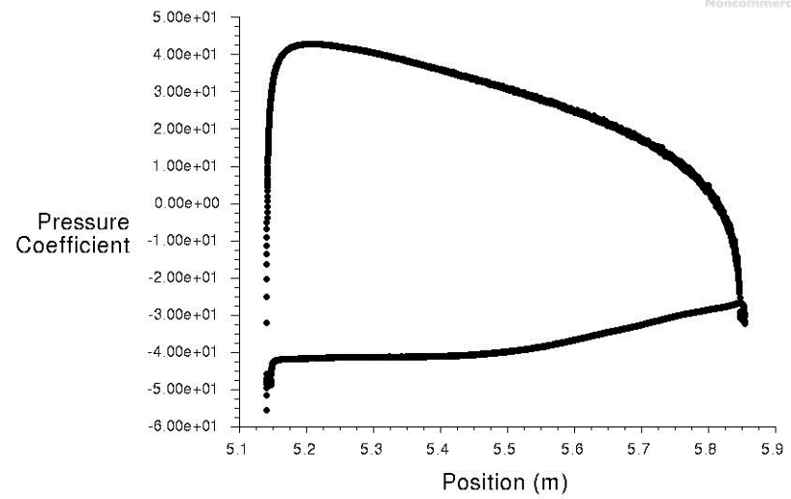
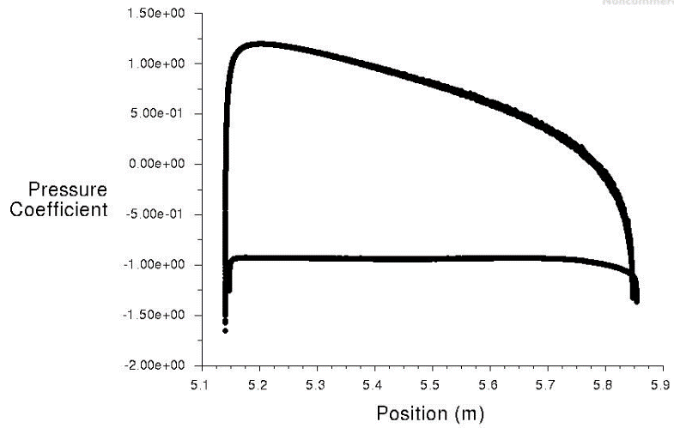
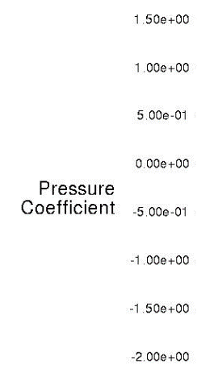
rýchlosti prúdenia 6 m/s a 20 m/s
Alfa = 5°
Alfa = 20°
Alfa = 45°

Slide 23
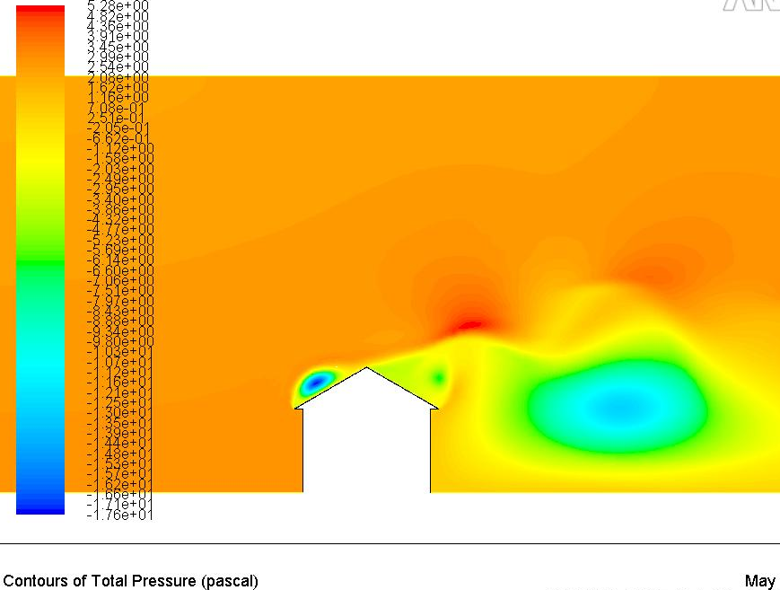
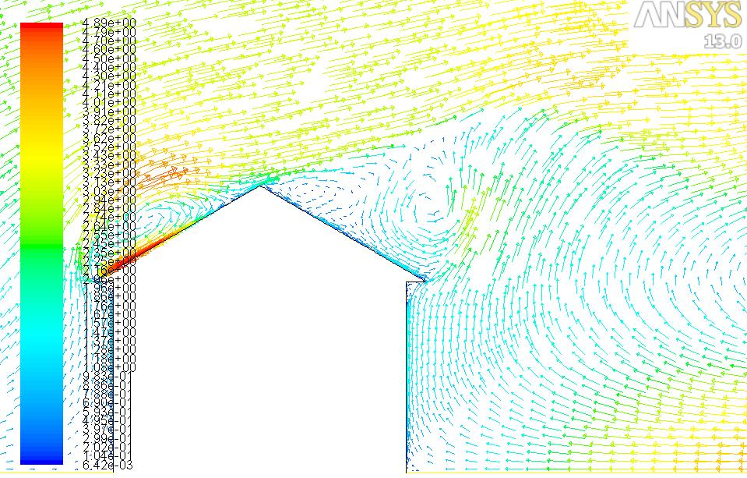
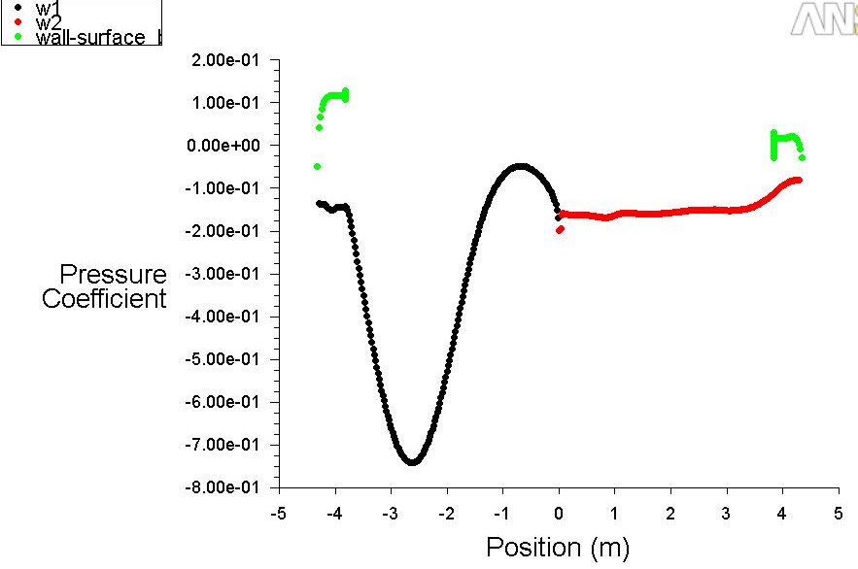
Modelovanie prúdenia vzduchu v okolí strechy budovy
rýchlosti prúdenia 2 m/s
distribúcia tlaku,
vektory prúdenia
tlakový koeficient

Slide 24
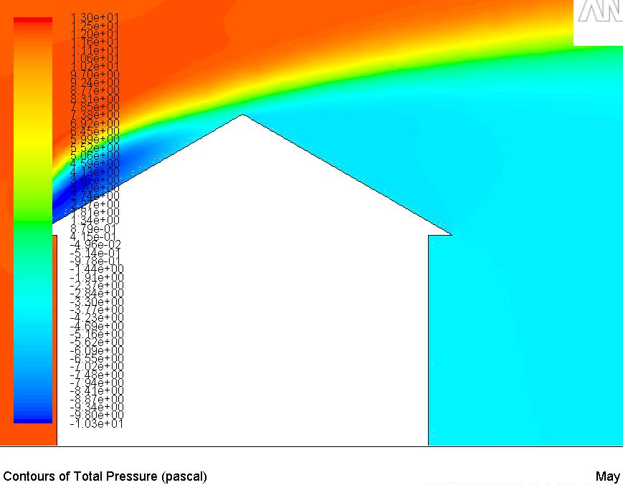
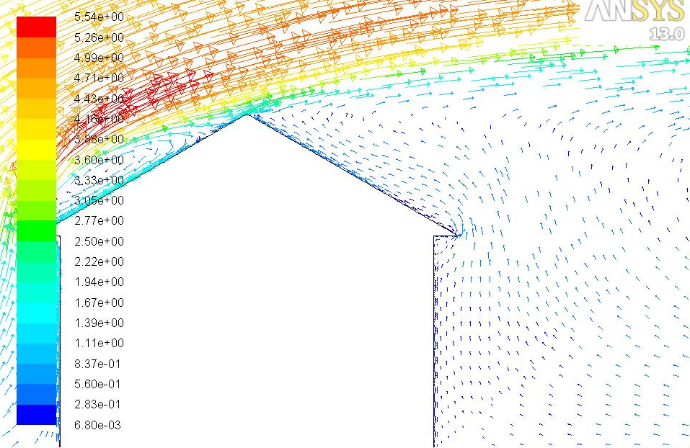
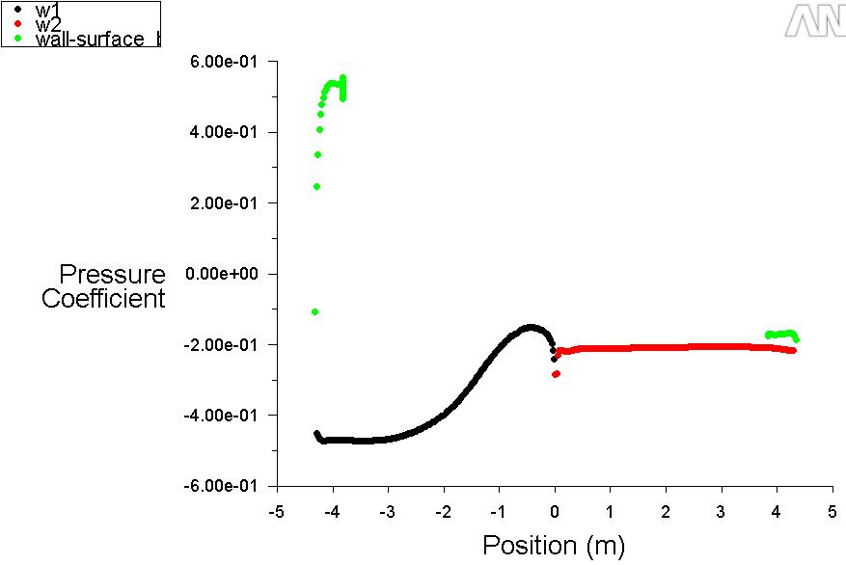
Modelovanie prúdenia vzduchu v okolí strechy budovy
rýchlosti prúdenia 4 m/s
distribúcia tlaku,
vektory prúdenia
tlakový koeficient

Slide 25
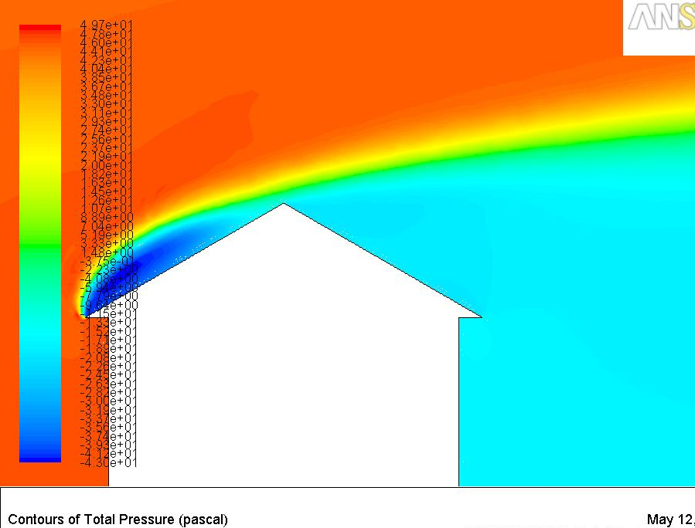
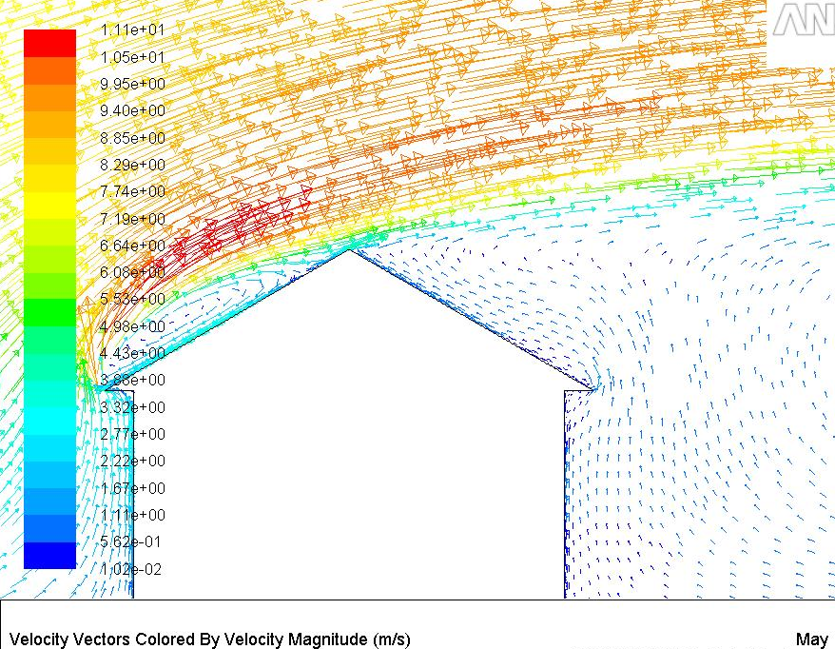
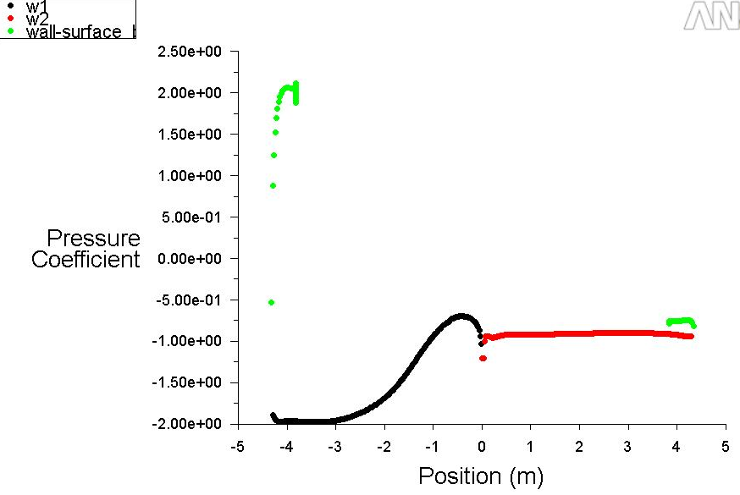
Modelovanie prúdenia vzduchu v okolí strechy budovy
rýchlosti prúdenia 6 m/s
distribúcia tlaku,
vektory prúdenia
tlakový koeficient

Slide 26
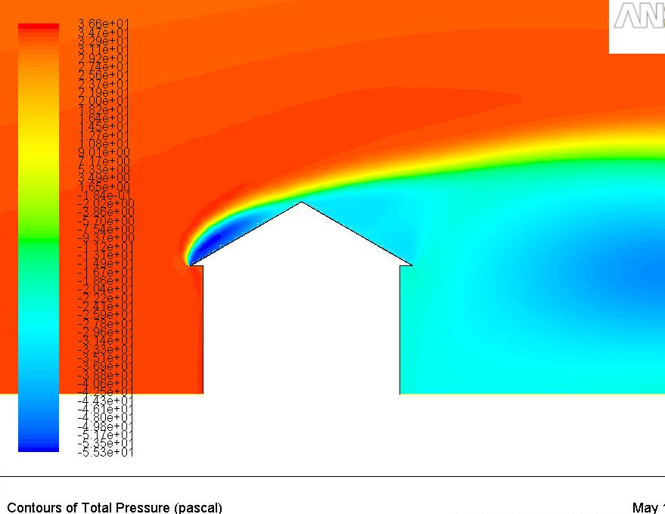
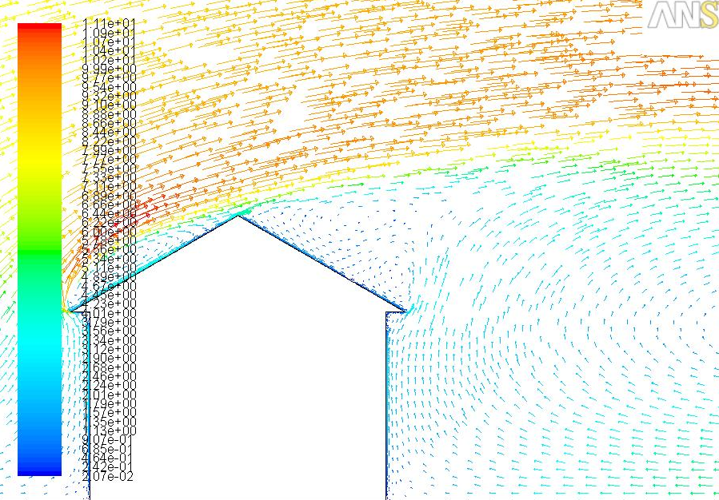
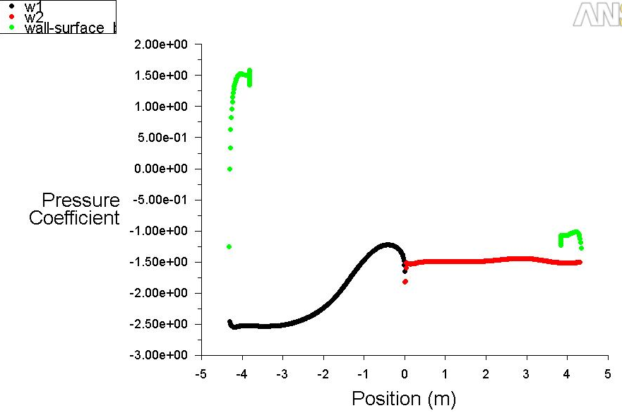
Modelovanie prúdenia vzduchu v okolí strechy budovy
rýchlosti prúdenia 20 m/s
distribúcia tlaku,
vektory prúdenia
tlakový koeficient

Slide 27
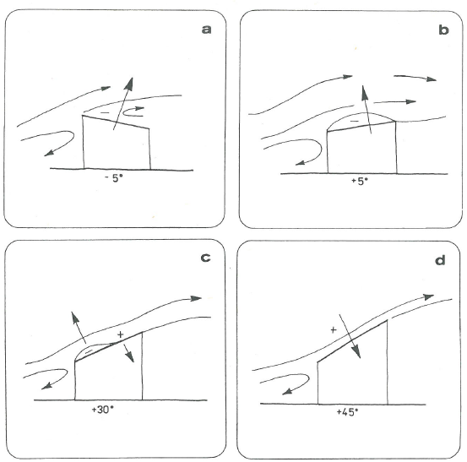
Prúdenie pri rôznych uhloch sklonu strechy

Slide 28
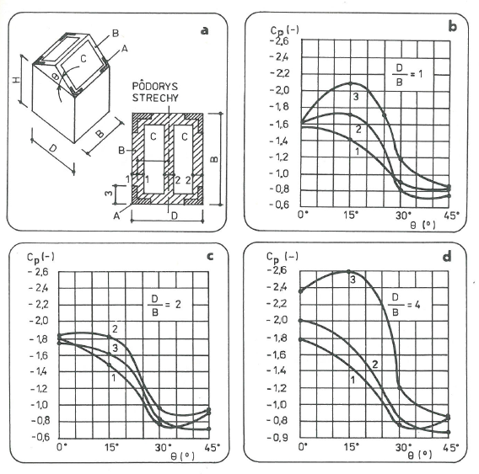
cp pri rôznych uhloch sklonu strechy,
1) H/B =0,5
2) H/B = 1
3) H/B = 1,5

Slide 29
Flow parallel to plate –
viscous forces important and Re dependence
Flow perpendicular to plate –
pressure forces important and no strong Re dependence
What about Re dependence
for flow around sphere?
C_{D}
?
Re

Slide 30
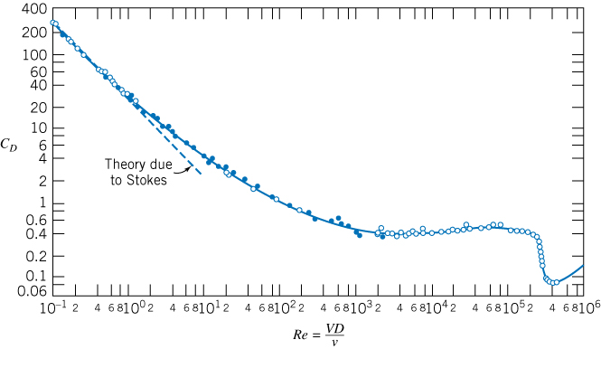
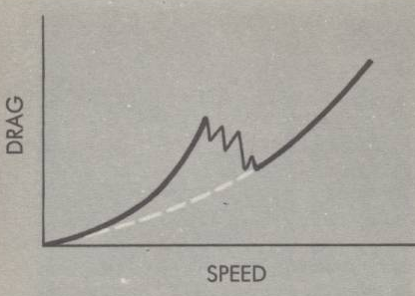
Drag Coefficient, C_{D}, as a function of Re for a Smooth Sphere
SMOOTH SPHERE

Slide 31
Drag Coefficient, C_{D}, as a function of Re for a Smooth Sphere
F_{D} = 3πμVD
C_{D} = ?
SMOOTH SPHERE

Slide 32
Laminar
Flow
Laminar boundary layer
Turbulent flow in wake
Separation point moving forward
Separation point fixed
*
Turbulent
boundary
layer
*
C_{D} = F_{D}/(½ ρU²πR²)
= 6πμUR/(½ ρU²πR²)
= 24/Re
95% of drag due to pressure
difference between front and back

Slide 33
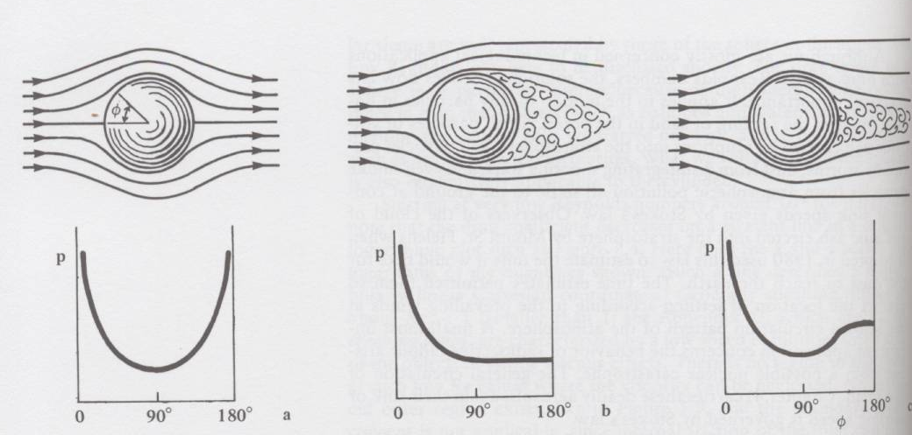
S e p a r a t i o n
IDEAL FLOW* LAMINAR δ FLOW TURBULENT δ FLOW

Slide 34
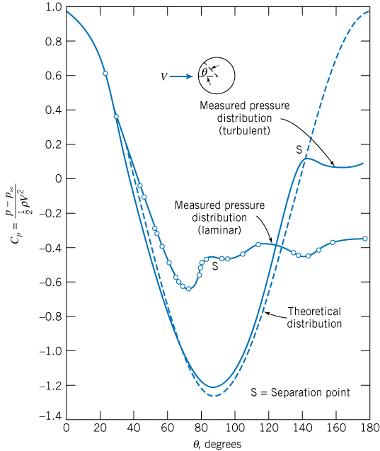
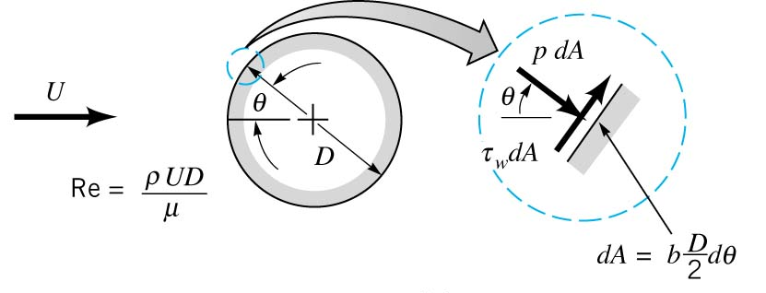
PRESSURE DRAG
DRAG
~120º
IF NO VISCOSITY
WHAT WOULD BE
TOTAL DRAG ?
~82º

Slide 35
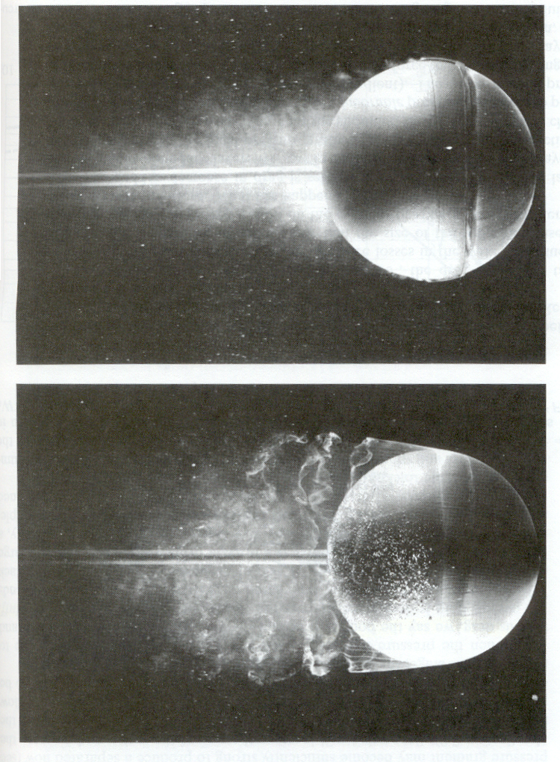
By roughening surface
can “trip” boundary layer
so turbulent which results
in a favorable momentum
exchange, pushing
separation point further
downstream, resulting
in a smaller wake and
reduced drag.
125 yd drive with smooth
golf ball becomes 215 yds
for dimpled*
From Van Dyke, Album of Fluid Motion
Parabolic Press, 1982; Original photographs
By Werle, ONERA, 1980
Trip
Re = 30000
Smooth
Re = 15000
Notes:
SHAPE & FLOW
230 yards for dimples
50 yards for smooth

Slide 36
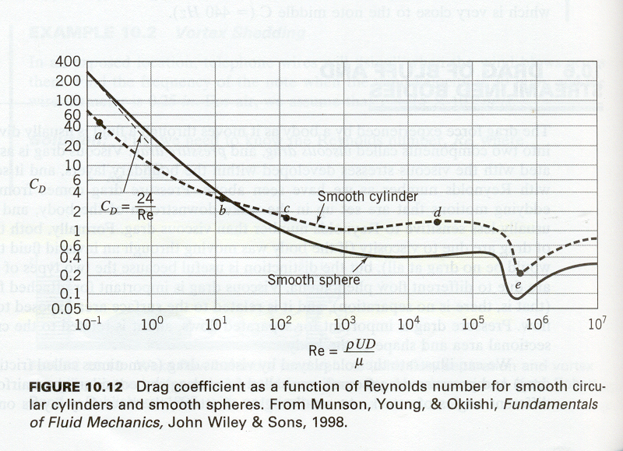
ASIDE: At low very low Reynolds numbers Drag α μUL
D ~ U
C_{D} = D / (¹/₂ ρ U²A_{f})
C_{D} = constant
D ~ U²
Drag coefficient as a function of Reynolds number for smooth circular
cylinders and smooth spheres. From Munson, Young, & Okiishi,
Fundamentals of Fluid Mechanics, John Wiley & Sons, 1998

Slide 37
ASIDE: At low very low Reynolds numbers Drag α μUL
D ~ U
C_{D} = D / (¹/₂ ρ U²A_{f})
C_{D} = constant
D ~ U²
Drag coefficient as a function of Reynolds number for smooth circular
cylinders and smooth spheres. From Munson, Young, & Okiishi,
Fundamentals of Fluid Mechanics, John Wiley & Sons, 1998

Slide 38
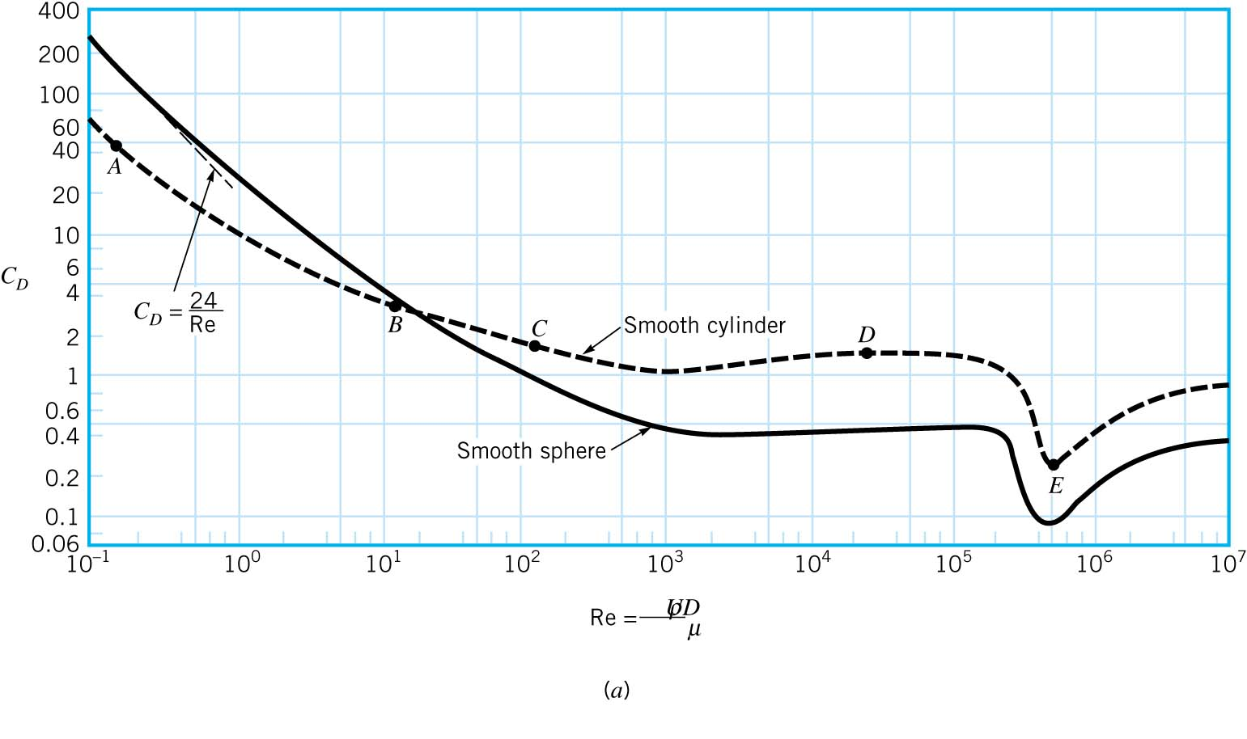
3-D relieving effect
C_{dcylinder}>C_{Dsphere}
Re_{Dcrit} ~ 3 x 10⁵
Drag coefficient as a function of Re
for a smooth cylinder and smooth sphere.
Is Re_{Dcritical} constant?

Slide 39
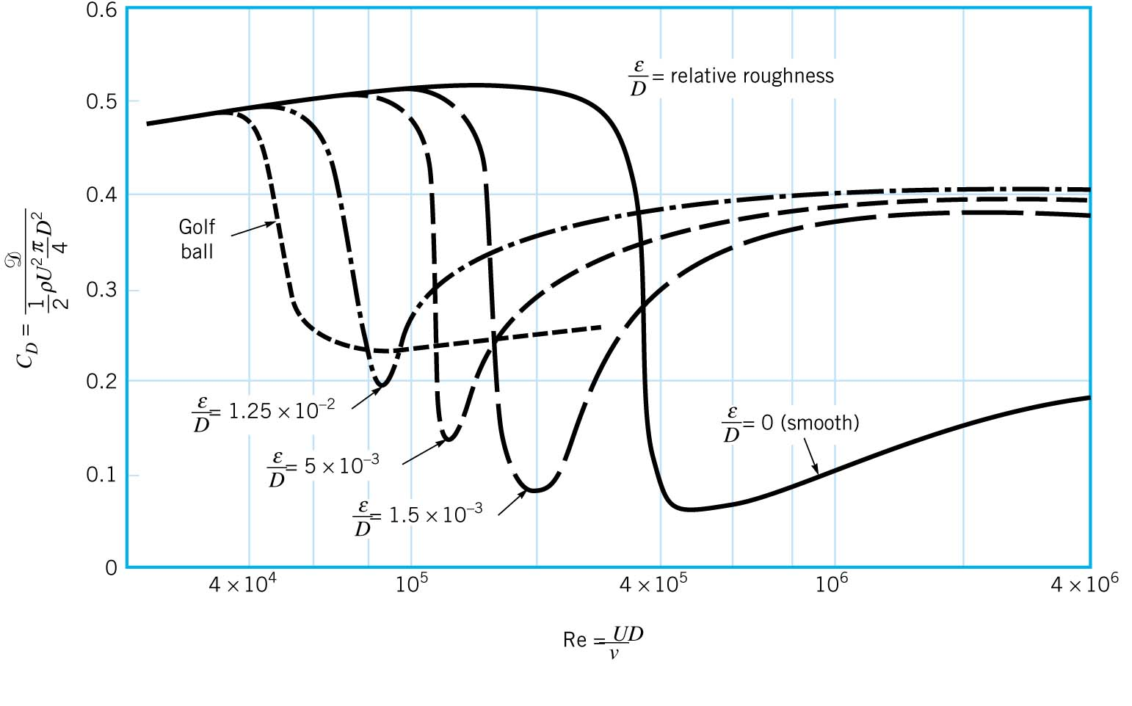
Effect of surface roughness on the drag coefficient of a sphere in the
Reynolds number range where laminar boundary layer becomes turbulent.

Slide 40
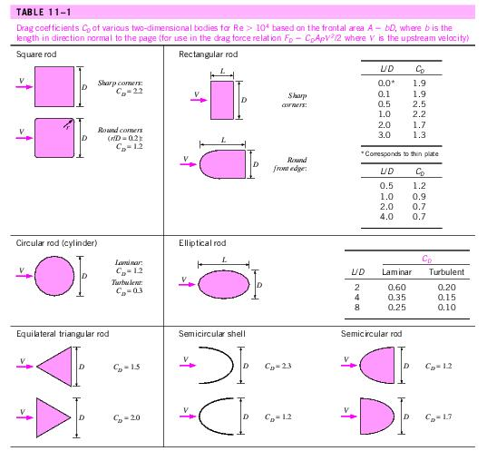
C_{D} of Common Geometries

Slide 41
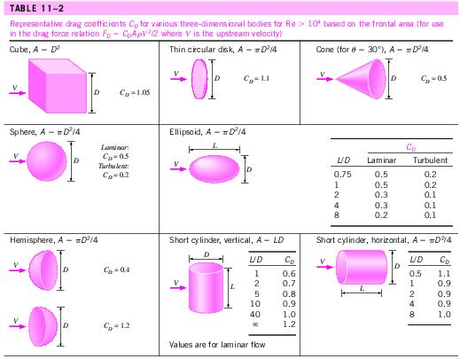
C_{D} of Common Geometries

Slide 42

C_{D} of Common Geometries

